Slide 1
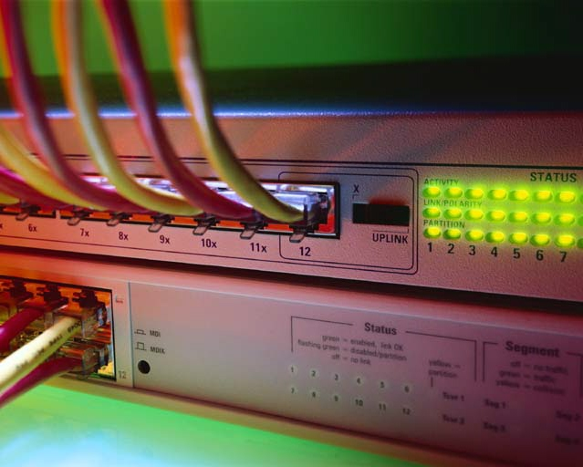
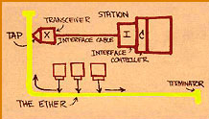
Ethernet LANs
Chapter 4
Panko’s
Business Data Networks and
Telecommunications, 5th edition
Copyright 2005 Prentice-Hall

Slide 2
Perspective
Ethernet is the dominant LAN technology
  You need to know it well
Basic Ethernet switching is very simple
However, large Ethernet networks require more advanced knowledge

Slide 3
Ethernet History
Developed at Xerox Palo Alto Research Center in the 1970s
  After a trip to the University of Hawai`i’s Alohanet project
Taken over by the IEEE
  802 LAN/MAN Standards Committee is in charge of LAN Standards
  802.3 Working Group develops Ethernet standards
  Other working groups create other standards

Slide 4
Ethernet Standards are OSI Standards
Ethernet standards are LAN standards
LANs (and WANs) are single networks
Single networks are based on Layer 1 (physical) and Layer 2 (data link) standards
OSI dominates standards at these layers
Ethernet standards are OSI standards
  Must be ratified by ISO, but this is a mere formality

Slide 5

Ethernet Physical Layer Standards

Slide 6
Figure 4-1: Ethernet Physical Layer Standards
Physical
Layer
Standard
Speed
Maximum
Run
Length
Medium
UTP
10Base-T
10 Mbps*
100 meters
4-pair Category 3
or better
100Base-TX
100 Mbps
100 meters
4-pair Category 5
or better
1000Base-T
1,000 Mbps
100 meters
4-pair Category 5
or better
*With autosensing, 100Base-TX NICs and switches will slow to
10 Mbps for 10Base-T devices. Often called 10/100 Ethernet

Slide 7
Figure 4-1: Ethernet Physical Layer Standards, Continued
Physical
Layer
Standard
Speed
Maximum
Run
Length
Medium
Optical Fiber
100Base-FX
100 Mbps
2 km
62.5/125 multimode,
1300 nm, switch
https://en.wikipedia.org/wiki/Optical_fiber_connector

Slide 8
Figure 4-1: Ethernet Physical Layer Standards, Continued
Physical
Layer
Standard
Speed
Maximum
Run
Length
Medium
1000Base-SX
1 Gbps
220 m
62.5/125 micron multimode,
850 nm, 160 MHz-km
modal bandwidth
1000Base-SX
1 Gbps
275 m
62.5/125 micron multimode,
850 nm, 200 MHz-km
1000Base-SX
1 Gbps
500 m
50/125 micron multimode,
850 nm, 400 MHz-km
1000Base-SX
1 Gbps
550 m
50/125 micron multimode,
850 nm; 500 MHz-km
Gigabit Ethernet, 850 nm, various core sizes and modal bandwidths

Slide 9
Figure 4-1: Ethernet Physical Layer Standards, Continued
Physical
Layer
Standard
Speed
Maximum
Run
Length
Medium
1000Base-LX
1 Gbps
550 m
62.5/125 micron multimode,
1310 nm
1000Base-LX
1 Gbps
5 km
9/125 micron single mode,
1310 nm
Gigabit Ethernet, 1300 nm, multimode versus single mode

Slide 10
Perspective
Access links to client stations today are dominated by 100Base-TX
Trunk links today are dominated by 1000Base-SX
  Short trunk links, however, use UTP
  Longer and faster trunk links use other fiber standards

Slide 11
Figure 4-1: Ethernet Physical Layer Standards, Continued
Physical
Layer
Standard
Speed
Maximum
Run
Length
Medium
10GBase-SR/SW
10 Gbps
65 m
62.5/125 micron
multimode, 850 nm
10GBase-LX4
10 Gbps
300 m
62.5/125 micron
multimode, 1300 nm,
WDM with 4 lambdas
10 Gbps Ethernet, multimode
S = 850 nm, L = 1300 nm
R=LAN, W=WAN

Slide 12
Figure 4-1: Ethernet Physical Layer Standards, Continued
Physical
Layer
Standard
Speed
Maximum
Run
Length
Medium
10GBase-LR/LW
10 Gbps
10 km
9/125 micron single
mode, 1300 nm.
10GBase-ER/EW
10 Gbps
40 km
9/125 micron single
mode, 1550 nm.
10 Gbps Ethernet, for wide area networks
L = 1300 nm, E = 1550 nm
R = LAN, W = WAN

Slide 13
Figure 4-1: Ethernet Physical Layer Standards, Continued
Physical
Layer
Standard
Speed
Maximum
Run
Length
Medium
40 Gbps
Ethernet
40 Gbps
Under
Development
9/125 micron
single mode.

Slide 14
Figure 4-1: Ethernet Physical Layer Standards, Continued
Notes:
  For 10GBase-x, LAN versions (R) transmit at 10 Gbps. WAN versions (W) transmit at 9.95328 Gbps for carriage over SONET/SDH links (see Chapter 6)
  The 40 Gbps Ethernet standards are still under preliminary development

Slide 15
Figure 4-2: Baseband Versus Broadband Transmission
Baseband Transmission
Signal
Transmitted Signal (Same)
Source
Transmission Medium
Signal is injected directly into the transmission medium
(wire, optical fiber)
Inexpensive, so dominates wired LAN transmission technology

Slide 16
Figure 4-2: Baseband Versus Broadband Transmission, Continued
Broadband Transmission
Modulated Signal
Radio Channel
Source
Radio
Tuner
Signal is first modulated to a higher frequency,
then sent in a radio channel
Expensive but needed for radio-based networks

Slide 17
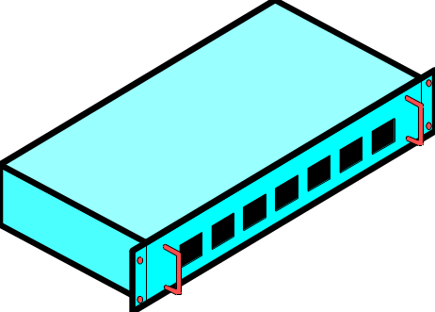
Figure 4-3: Link Aggregation (Trunking)
100Base-TX Switch
Two links provide 200 Mbps of trunk
capacity between the switches
No need to buy a more expensive
Gigabit Ethernet port
Switch must support link aggregation
(trunking)
UTP
Cord
UTP
Cord
100Base-TX Switch

Slide 18


Figure 4-4: Data Link Using Multiple Switches
Original
Signal
Received
Signal
Regenerated
Signal
Switches regenerate signals before sending them out;
this removes errors

Slide 19
Figure 4-4: Data Link Using Multiple Switches, Continued
Received
Signal
Original
Signal
Received
Signal
Regenerated
Signal
Received
Signal
Regenerated
Signal
Thanks to regeneration, signals can travel far across
a series of switches

Slide 20
Figure 4-4: Data Link Using Multiple Switches, Continued
Received
Signal
Original
Signal
Received
Signal
Regenerated
Signal
Received
Signal
Regenerated
Signal
UTP
62.5/125
Multimode Fiber
UTP
100Base-TX
(100 m maximum)
Physical Link
1000Base-SX
(220 m maximum)
Physical Link
100Base-TX
(100 m maximum)
Physical Link
Each transmission line along the way has a distance limit.

Slide 21
Figure 4-4: Data Link Using Multiple Switches, Continued
Received
Signal
Original
Signal
Received
Signal
Regenerated
Signal
Received
Signal
Regenerated
Signal
UTP
62.5/125
Multimode Fiber
UTP
100Base-TX
(100 m maximum)
Physical Link
1000Base-SX
(220 m maximum)
Physical Link
100Base-TX
(100 m maximum)
Physical Link
Data Link Does Not Have a Maximum Distance
(420 m distance spanned in this example)

